Slide 1

PaaS & SaaS
By
Mr. Saurabh Singhal
Assistant Professor
Department of Computer Engineering & Applications
GLA University

Slide 2
What is PaaS?
Platform as a service (PaaS) is a complete development and deployment environment in the cloud, with resources that enable user to deliver everything from simple cloud-based apps to sophisticated, cloud-enabled enterprise applications.
User purchase the resources required from a cloud service provider on a pay-as-you-go basis and access them over a secure Internet connection.
Like IaaS, PaaS includes infrastructure—servers, storage and networking—but also middleware, development tools, business intelligence (BI) services, database management systems and more.

Slide 3
What is PaaS?
PaaS is designed to support the complete web application lifecycle: building, testing, deploying, managing and updating.
PaaS allows user to avoid the expense and complexity of buying and managing software licenses, the underlying application infrastructure and middleware, container orchestrators such as Kubernetes or the development tools and other resources.

Slide 4
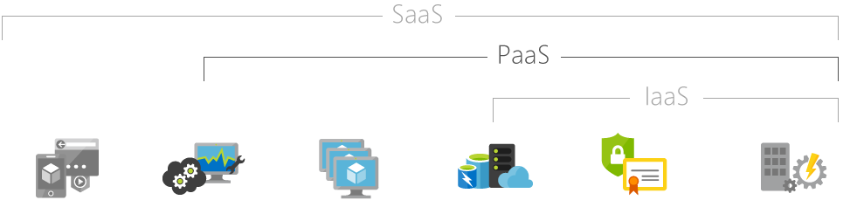
What is PaaS?
Hosted applications/apps | Development tools, database management, business analytics | Operating systems | Servers and storage | Networking firewalls/ security | Data center physical plant/building

Slide 5
Common PaaS scenarios
Organisations typically use PaaS for these scenarios:
Development framework. PaaS provides a framework that developers can build upon to develop or customise cloud-based applications.
Analytics or business intelligence. Tools provided as a service with PaaS allow organizations to analyze and mine their data, finding insights and patterns and predicting outcomes to improve forecasting, product design decisions, investment returns and other business decisions.
Additional services. PaaS providers may offer other services that enhance applications, such as workflow, directory, security and scheduling.

Slide 6
Advantages of PaaS
Cut coding time.
Add development capabilities without adding staff.
Develop for multiple platforms—including mobile—more easily.
Use sophisticated tools affordably. Support geographically distributed development teams.
Efficiently manage the application lifecycle.

Slide 7
Disadvantages of PaaS
Vendor lock-in
Data Privacy
Integration with the rest of the systems applications

Slide 8
Top vendors
Google Apps Engine (GAE)
SalesFroce.com
Windows Azure
AppFog
Openshift
Cloud Foundary from VMware

Slide 9
Service-Oriented Architecture (SOA)
A service-oriented architecture is essentially a collection of services.
These services communicate with each other.
The communication can involve either simple data passing or it could involve two or more services coordinating some activity.
Some means of connecting services to each other is needed.
A service is a function that is well-defined, self-contained, and does not depend on the context or state of other services.

Slide 10

Service-Oriented Architecture (SOA)
The technology of Web Services is the most likely connection technology of service-oriented architectures.

Slide 11
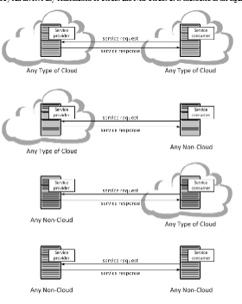
Service-Oriented Architecture (SOA)

Slide 12
Service-Oriented Architecture (SOA)
There are two major roles within Service-oriented Architecture:
Service provider: The service provider is the maintainer of the service and the organization that makes available one or more services for others to use. To advertise services, the provider can publish them in a registry, together with a service contract that specifies the nature of the service, how to use it, the requirements for the service, and the fees charged.
Service consumer: The service consumer can locate the service metadata in the registry and develop the required client components to bind and use the service.

Slide 13
Advantages of SOA
Service reusability
Easy maintenance
Platform independent
Availability
Reliability
Scalability

Slide 14
Disadvantages of SOA
High overhead
High investment
Complex service management

Slide 15
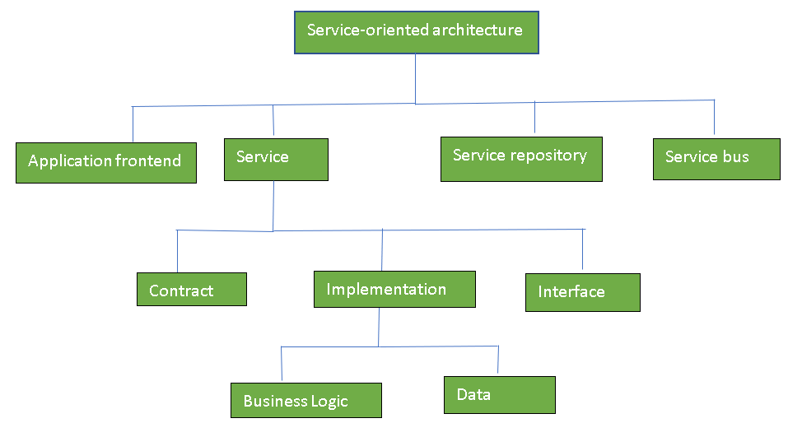
Components of SOA

Slide 16
SaaS
Software as a service (or SaaS) is a way of delivering applications over the Internet—as a service. Instead of installing and maintaining software, you simply access it via the Internet, freeing yourself from complex software and hardware management.
SaaS applications are sometimes called Web-based software, on-demand software, or hosted software. Whatever the name, SaaS applications run on a SaaS provider’s servers.
The provider manages access to the application, including security, availability, and performance

Slide 17
Advantages of SaaS
SaaS is easy to buy
Less hardware required for SaaS
Low Maintenance required for SaaS
No special software or hardware versions required

Slide 18
Disadvantages of SaaS
Security
Latency issue
Total Dependency on Internet
Switching between SaaS vendors is difficult

Slide 19
Open SaaS and SOA
A considerable amount of SaaS software is based on open source software.
When open source software is used in a SaaS, it is referred to as Open SaaS.
The advantages of using open source software are that systems are much cheaper to deploy because users don’t have to purchase the operating system or software, there is less vendor lock-in, and applications are more portable.
The impact of Open SaaS will likely translate into better profitability for the companies that deploy open source software in the cloud, resulting in lower development costs and more robust solutions.

Slide 20
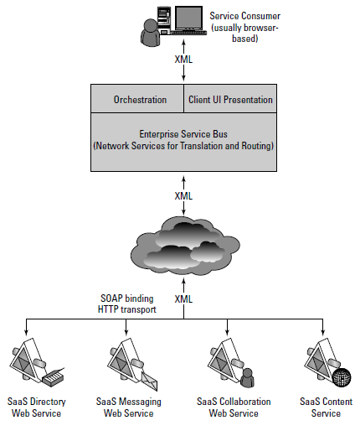

Slide 21
Open SaaS and SOA
The componentized nature of SaaS solutions enables many of these solutions to support a feature called mashups.
A mashup is an application that can display a Web page that shows data and supports features from two or more sources.
Annotating a map such as Google maps is an example of a mashup.
Mashups are considered one of the premier examples of Web 2.0, and that is technology’s ability to support social network systems.

Slide 22
Web 2.0
Web 2.0 is the term used to describe a variety of web sites and applications that allow anyone to create and share online information or material they have created. A key element of the technology is that it allows people to create, share, collaborate & communicate
It’s a simply improved version of the first world wide web, characterized specifically by the change from static to dynamic or user-generated content and also the growth of social media.
The concept behind Web 2.0 refers to rich web applications, web- oriented architecture and social web. It refer to changes in the ways web pages are designed and used by the users, without any change in any technical specifications.

Slide 23
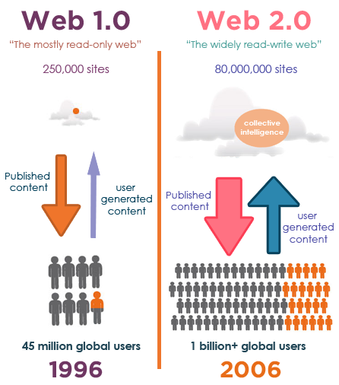

Slide 24
Advantages of Web 2.0
Available at any time, any place.
Variety of media.
Ease of usage.
Learners can actively be involved in knowledge building.
Can create dynamic learning communities.
Everybody is the author and the editor, every edit that has been made can be tracked.
User friendly
Updates in wiki are immediate and it offers more sources for researchers.
Provides real-time discussion

Slide 25
Differences between Web 1.o, Web 2.o
Web 1.0 | Web 2.0
Content | Speedy
destination sites and personal portals | more timely information and more efficient tools to find information
Search | Collaborative
critical mass of content drives need for search engines | actions of user a mass, police, and prioritize content
Commerce | Trust-worthy
goes mainstrean; digital good rise | user establish trust networks and home trust radars

Slide 26
Technologies
The client-side technologies used in Web 2.0 development include Ajax and JavaScript frameworks.
Ajax programming uses JavaScript and the Document Object Model (DOM) to update selected regions of the page area without undergoing a full page reload.
To allow users to continue interacting with the page, communications such as data requests going to the server are separated from data coming back to the page

Slide 27
Concepts
Web 2.0 can be described in three parts:
Rich Internet application (RIA) — defines the experience brought from desktop to browser, whether it is "rich" from a graphical point of view or a usability/interactivity or features point of view.
Web-oriented architecture (WOA) — defines how Web 2.0 applications expose their functionality so that other applications can leverage and integrate the functionality providing a set of much richer applications.
Social Web — defines how Web 2.0 websites tend to interact much more with the end user and make the end user an integral part of the website

Slide 28
WebOS
WebOS is a Linux-based proprietary mobile operating system. This mobile OS runs on devices like Palm Pre phones, Palm Pixi phones and the HP Veer.
There are two ways of developing WebOS applications:
By using JavaScript, HTML and CSS. This requires the software development kit, which can be installed on a computer running OS X, Windows or Ubuntu.
By using C or C++., This requires the platform development kit, which can only run on Windows and Mac computers.

